Slide 1
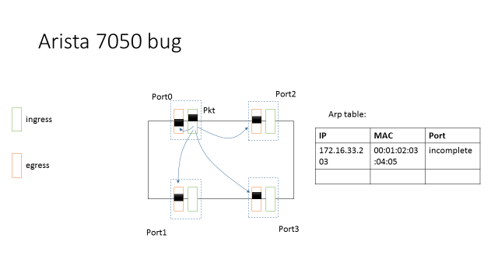
Deadlock caused by device bugs
Arista-7050QX32 bug：When the Arp table becomes incomplete because the corresponding MAC entry in the MAC table is wiped out (e.g., due to MAC table timeout), instead of handling the packets to the CPU or drop the packet, the switch broadcasts the packet to all the ports including itself.

Slide 2
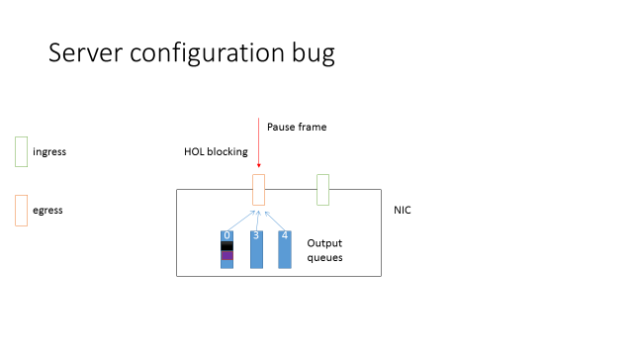
Deadlock caused by device bugs
Server configuration bug: In Mellanox NIC, there are 8 output queues. Normally we should put RDMA traffic and the rest traffic into different queues.
Due to the misconfiguration, all the packets went to the default queue.

Slide 3
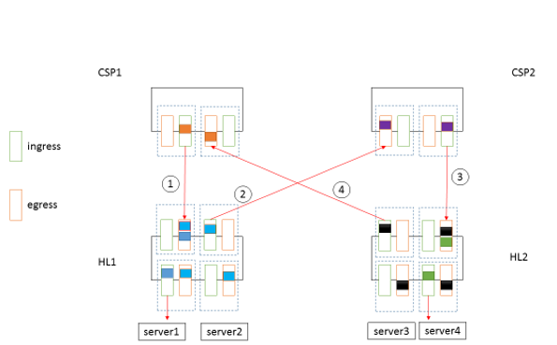
Deadlock caused by device bugs
Server 1 has data to send from HL1 to CSP1 to somewhere in the network. But there are congestion in the network, and CSP1 is sending pause frame to HL1;

Slide 4
Deadlock caused by device bugs
Server 1 has data to send from HL1 to CSP1 to somewhere in the network. But there are congestion in the network, and CSP1 is sending pause frame to HL1;
Server 4 is sending pkts to server 2, which is dead. HL1’s MAC entry for server 2 already timed out, but ARP entry for server 2 is still there. As a result, the blue packets are replicated to all the ports, and finally pause frame is generated from HL1 to CSP2;

Slide 5
Deadlock caused by device bugs
Server 1 has data to send from HL1 to CSP1 to somewhere in the network. But there are congestion in the network, and CSP1 is sending pause frame to HL1;
Server 4 is sending pkts to server 2, which is dead. HL1’s MAC entry for server 2 already timed out, but ARP entry for server 2 is still there. As a result, the blue packets are replicated to all the ports, and finally pause frame is generated from HL1 to CSP2;
Pause frames propagate, and CSP2 begins to send pause to HL2;

Slide 6
Deadlock caused by device bugs
Server 1 has data to send from HL1 to CSP1 to somewhere in the network. But there are congestion in the network, and CSP1 is sending pause frame to HL1;
Server 4 is sending pkts to server 2, which is dead. HL1’s MAC entry for server 2 already timed out, but ARP entry for server 2 is still there. As a result, the blue packets are replicated to all the ports, and finally pause frame is generated from HL1 to CSP2;
Pause frames propagate, and CSP2 begins to send pause to HL2;
Now suppose the black packet arrives at HL2 and destines to server 3, which is also dead. The packet is broadcasted to all the ports, which eventually triggers pause from HL2 to CSP1.

Slide 7
Some observations about deadlock problem
Some deadlocks are caused by a complicated interaction of several network errors, which is hard to debug and fix in a short time.
Only breaking the deadlock is not sufficient to bring the network back to a normal state. It is important to troubleshoot the root causes behind the deadlocks.

Slide 8
Two requirements for the solution
The solution should be fine-grained enough to detect and diagnose the root causes behind the observed problems.
The solution should be general enough to work for all the possible problems that may occur in the RDMA data centers.

Slide 9
A finite state machine based solution
Application
Update
Report
Feedback
Controller
<pattern set, reaction set>
Network Device
<state, action set>
Update
Each network device is a finite state machine:
State: normal, debug, recovery…
Action: drop blocked pkts, insert an FIB, delete an FIB, disable PFC on some specific port, restart…

Slide 10
A finite state machine based solution
Application
Update
Report
Feedback
Controller
<pattern set, reaction set>
Network Device
<state, action set>
Update
The Controller will match the patterns with the feedback messages from the network devices and react accordingly:
Pattern: device failure && routing loop && PFC deadlock;
Reaction: update the states and action sets of all the related devices && report device failure.

Slide 11
A finite state machine based solution
S₂
Action set 1
Action set 2
S₁
S₃
Deadlock
Action set 3
S₀
Action set 3
Mad NIC
S₃
S₁
Action set 1
Action set 2
S₂

